Slide 1

PeBLS
Pediatric Basic Life Support
Jason Grainger BS, CCEMT-P, I/C

Slide 2
Objectives
Define Pediatric Age Classifications
Review of Injury Prevention
Review of Pediatric:
  Burns
  Poisoning
  Drowning
  Playground Safety
  Sports Safety
  Falls
  Road Traffic Safety

Slide 3
Objectives
Review of Spinal Immobilization Techniques
Review of Splinting Techniques
Review of Traumatic Brain Injuries
Review of Pediatric Abuse
Review Mandatory Reporting Criteria

Slide 4
Age Groups
Neonate: Birth – 1 Month
Infant: 1 Month – 12 Months
Toddler: 1 Year – 3 Years
Preschool: 3 Years – 6 Years
School Age: 6 Years – 12 Years
Adolescent: 12 Year – 18 Years

Slide 5
Pediatric Trauma
Trauma is the leading cause of death for patients aging from 0-19 years old. According to the CDC, 12,175 children die, in the US, on an annual basis. Additionally, an estimated 9.2 MILLION patients are evaluated at the ER for an unintentional injury.
https://www.cdc.gov/safechild/child_injury_data.html

Slide 6
Fatal Injuries
Males have a higher death rate than females, almost 2:1, and male fatalities outnumbered females in all childhood age groups
Highest death rates as a result from MVA
A significant number of pedestrian and pedal bike incidents occurred
The poisoning death rate for 15 and above was 5x the rate of other age groups
The suffocation death rate for Infants was 16x the rate of all other age groups

Slide 7
Nonfatal Injuries
Males have a higher rate of occurrence
Falls account for over 50% of the injuries in children less than 1 year old, and is the leading cause for all categories less than 15
Other causes were due to blunt force trauma, insect/animal bites, and overexertion
Suffocation was highest for infants
Burns and Drowning was highest in patients less than 4 years old
Children 1-4 had the highest rate of nonfatal poisonings
MVA leading cause for 15 year old and above

Slide 8
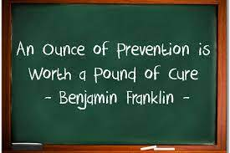
Prevention

Slide 9
Prevention
Primary
  Preventing the injury before it occurs.
Secondary
  Reduce the impact of an injury that has already occurred.
Tertiary
  Lessen the impact of an ongoing injury that has lasting effects.

Slide 10
Injury Categories
Burns
Drowning
Sports Safety
Road Traffic Safety
Poisoning
Playground Safety
Falls
Abuse / Neglect

Slide 11
Burns
According to the CDC, there are 300 pediatric burns daily. Of these, 2 will succumb to their injuries…
Yearly totals:
109,500 pediatric burns
730 pediatric deaths

Slide 12
Burns
The body surface area compared to mass is greater for infants and children, when compared to adults. This can have increased effects concerning fluid loss, heat loss, shock, and airway difficulties.

Slide 13
Superficial Burns
AKA 1st Degree
Only the epidermis is effected
Red skin
Painful at the site

Slide 14
Partial Thickness
AKA 2nd Degree
The epidermis and the dermis are effected
Blisters
Intense pain
White to red skin
Moist and mottled skin

Slide 15
Full Thickness
AKA 3rd Degree
The epidermis, dermis, and subcutaneous layers are effected
Charring, dark brown, or white skin
Skin may be hard to the touch
Little or no pain centrally, pain may be present at the periphery of the burn

Slide 16
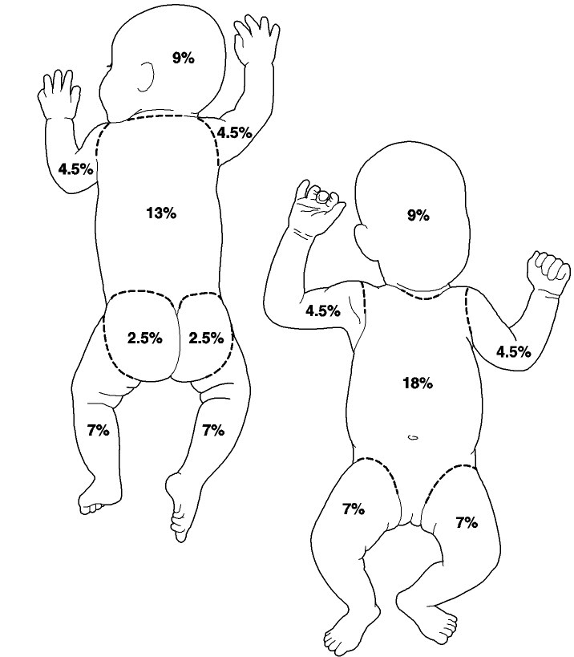
Rule of Nines

Slide 17
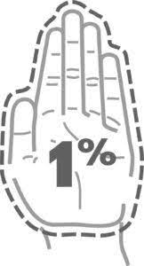
Rule of Palm

Slide 18
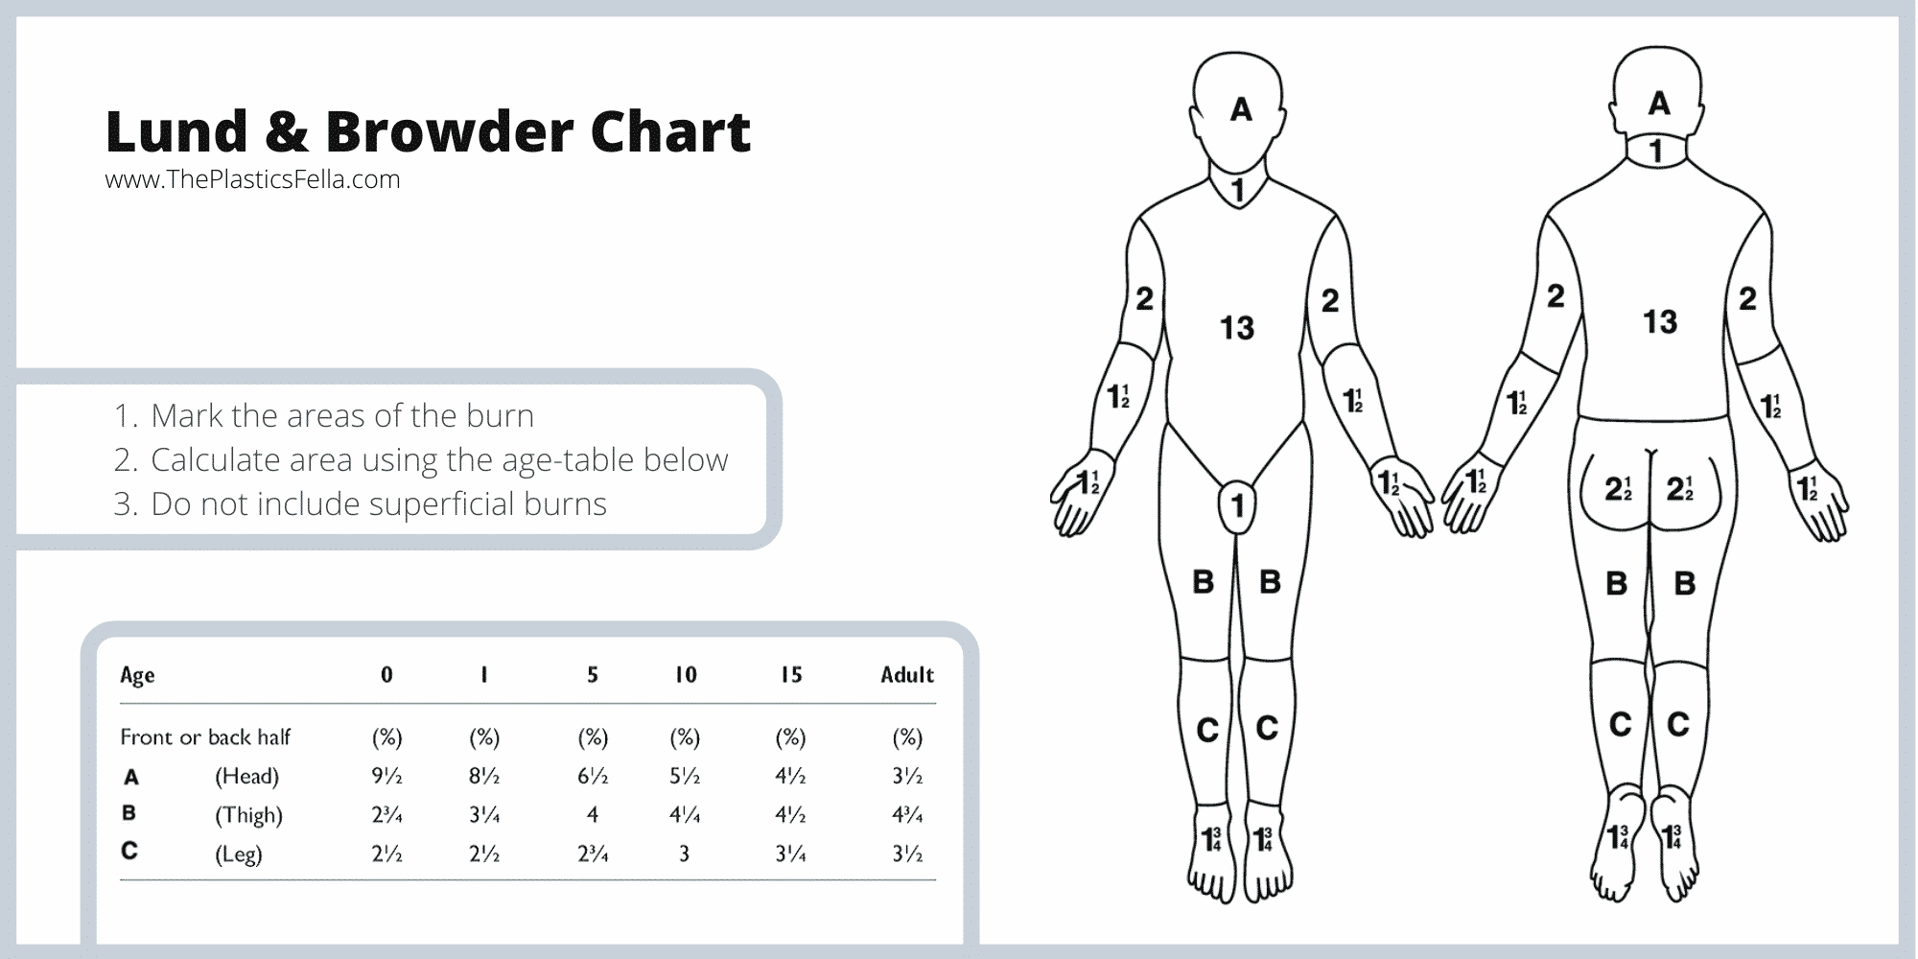
Lund and Browder

Slide 19
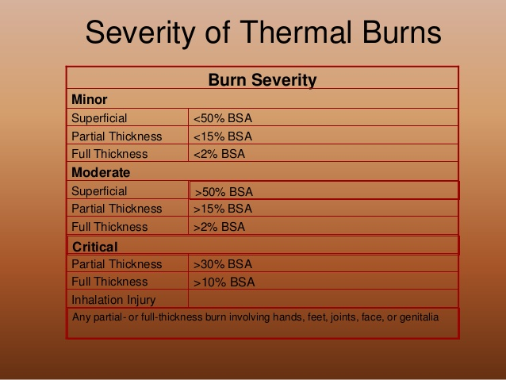
Burn Classifications

Slide 20
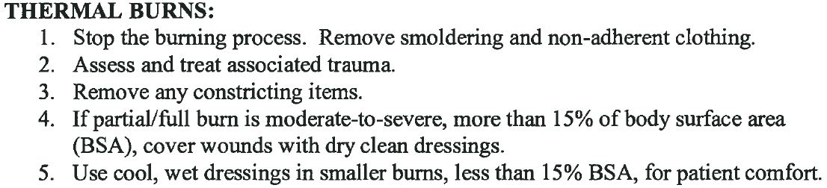
NEMMCA 3-5 pg 1

Slide 21
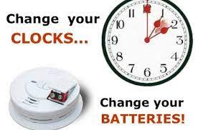
Primary Burn Prevention
Be “ALARMED”
  Change your time, Change your Batteries

Slide 22
Primary Burn Prevention
Close before you Doze
  https://www.erieinsurance.com/blog/close-before-you-doze#:~:text=Close%20Before%20You%20Doze,-See%20the%20Dramatic&text=Here's%20why%20it%20works%3A%20Fires,fire%20extinguisher%20nearby%20can%20help.

Slide 23
Primary Burn Prevention
Have an escape plan in place, and PRACTICE makes perfect!
  https://www.nfpa.org//-/media/Files/FPW/Educate/2019/FPW19Grid.pdf

Slide 24
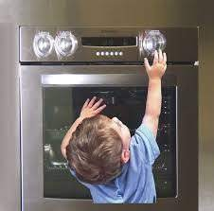
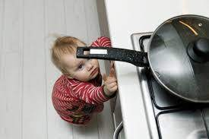
Primary Burn Prevention
Cook with Care

Slide 25
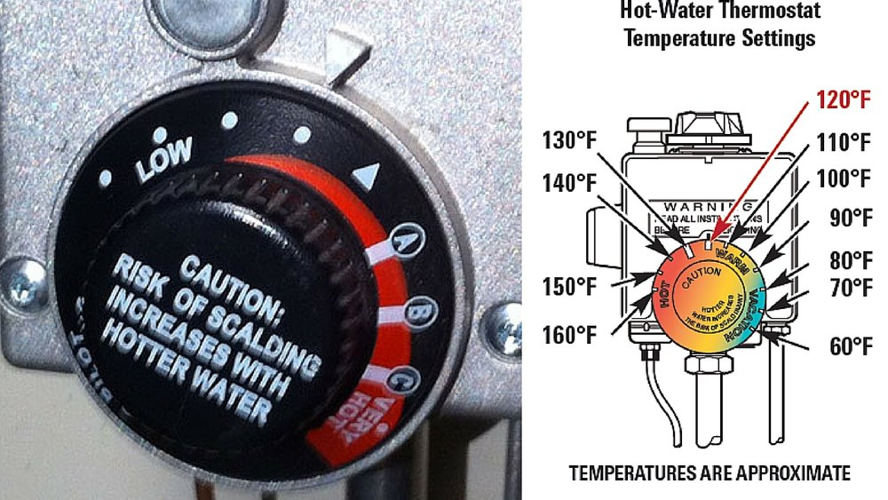
Primary Burn Prevention
Check the Hot Water Heater Temperature

Slide 26



Primary Burn Prevention

Slide 27
Secondary Burn Prevention
First Aid Education
  Lay person education for burn management
Optimal Prehospital and Hospital Care
  Prevent Shock and Respiratory Compromise
  Use Due diligence to minimalize infection
  Assure adequate nutrition for the patient
  *Both pre-hospital and hospital care play an important role in the management of burn patients by preventing deaths and disability.

Slide 28
Tertiary Burn Prevention
Rehabilitation
  Burn survivors are often left with disability and/or disfigurement that can hamper their lives physically and mentally. Measures such as psychologic and physical therapy can assure a better life in burn survivors.
  Q: How might this become the responsibility of EMS?
  A: Community EMT!

Slide 29
Poisoning
According to the CDC, there are 300 pediatric poisonings daily. Of these, 2 will succumb to their injuries…
Yearly totals:
  109,500 pediatric poisonings
  730 pediatric deaths

Slide 30
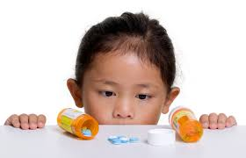
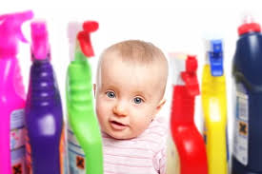
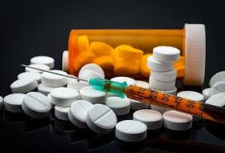
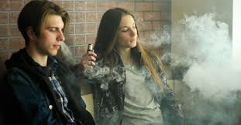
Poisoning
Accidental
  Toddlers
Intentional
  Adolescents

Slide 31
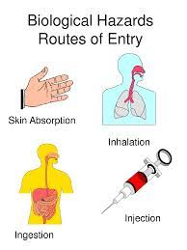
Routes on Entry
Injection
Inhalation
Ingestion
Absorption

Slide 32
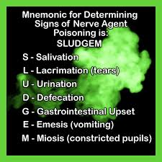
Poisoning

Slide 33
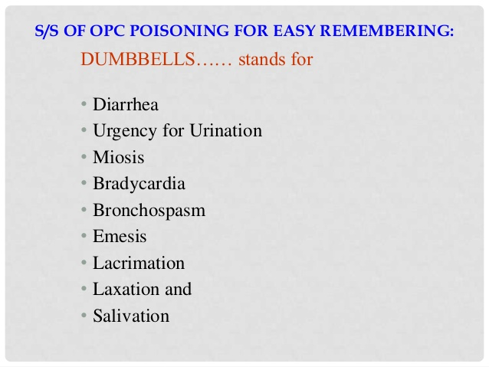
Poisoning

Slide 34

Primary Poisoning Prevention
Lock Them UP!!!
  Household Cleaners and Medications
    Keep them in the original package to emergency information is readily available, and the substance can be correctly identified

Slide 35

Primary Poisoning Prevention
Read the Label
  Make sure to follow the guidelines for medications (6 R’s of Medication Administration)
  DO NOT CALL MEDICINE “CANDY”

Slide 36

Primary Poisoning Prevention
Let it go!
  Dispose of:
    Expired Medications
    Unused Medications
    Unneeded Medications

Slide 37
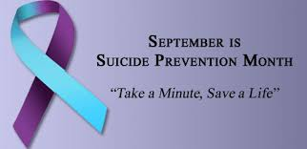
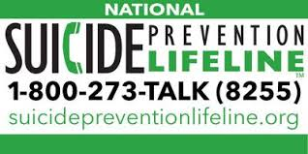
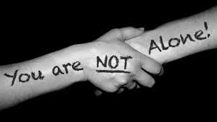
Primary Poisoning Prevention

Slide 38

Secondary Poisoning Prevention
Know the Number!

Slide 39
Secondary Poisoning Prevention
https://www.mclaren.org/Uploads/Public/Documents/Northern/nmmca/Northern_michigan_protocols.pdf
As prehospital providers, we must maintain an index of suspicion for abuse and neglect.

Slide 40
Tertiary Poisoning Prevention
Rehabilitation
  Intentional Poisoning Survivors may have their lives physically and mentally altered. Ongoing psychologic care may assure a better life, and potentially prevent future incidents.

Slide 41
Drowning
Drownings are a leading cause of injury death for young children ages 1 to 14
3 children die every day as a result of drowning
  1,095 annually
Drowning kills more children between the ages of 1-4 than anything else except birth defects

Slide 42

Drowning
Drowning:
  Submersion that results in asphyxia and death within 24 hours.
Near Drowning:
  If the patient survives longer than 24 hours, it is referred to as “near drowning.”

Slide 43
Primary Drowning Prevention
Learn Lifesaving Skills!
Life Jackets!
Fencing it off!
Be on the Lookout!

Slide 44

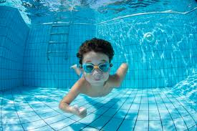
Primary Drowning Prevention
Learn/Teach Lifesaving Skills
                CPR
  Swimming Classes

Slide 45
Primary Drowning Prevention
Make Lifejackets a must!
  Life Jacket:
    designed to turn an unconscious person from a face down to a face up position
  Personal Flotation Device:
    broad term and refers to any device that aids in flotation or helps keep the wearer afloat

Slide 46
Life Jackets
Inspect
  Ensure there are no rips/tears
  All straps are functioning
Size
  Correctly size the life jacket for the user
Replace
  Although Life Jackets do not expire, it is recommended that they should be replaced every 10 years, or sooner if they become compromised
        Make sure the life jacket is U.S. Coast Guard-approved

Slide 47
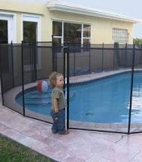
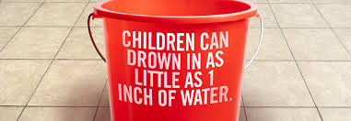

Primary Drowning Prevention
Fence it Off!

Slide 48

Primary Drowning Prevention
Be on the Lookout!

Slide 49
Be on the Lookout!
Closely supervise kids
  Avoid distractions such as:
    Cell Phones
    Reading Books
    ETOH
Utilize the buddy system
Know the meaning of, and obey warnings represented by colored beach flags

Slide 50
Secondary Drowning Prevention
Ensure scene safety
  Do not place yourself in harms way because of the age of the patient
Reach, Throw, Row, and Go…
Establish Time of submersion
  Cold water < 90 minutes (Water temp < 43F (6C)
  Warm water < 30 minutes (Water temp > 43F (6C)

Slide 51
Secondary Drowning Prevention
Obtain the patients core temperature
  If temperature is less than 86F (30C)
    Limit defibrillation to one attempt
    Limit medications to one dose
    Actively rewarm the patient
  If temperature is 86F (30C) or above
    Continue active rewarming of the patient
    Resume normal defibrillation intervals
    Resume medication administration*

Slide 52
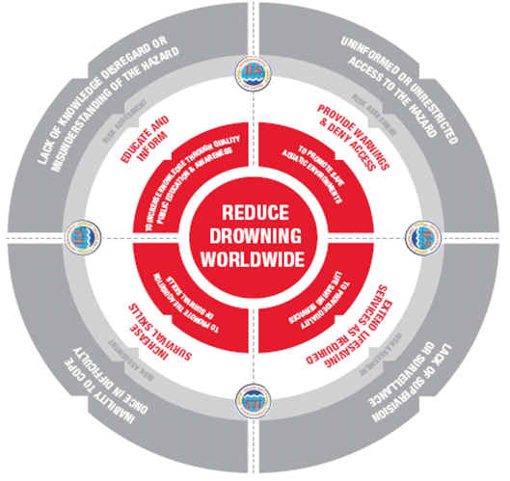
Tertiary Drowning Prevention

Slide 53
Playground Safety
Annually, more than 200,000 children, ages 14 and younger, are treated at the ER for playground-related injuries
  About 56% of playground-related injuries that are treated in EDs are fractures and contusions/abrasions.
  About 75% of injuries related to playground equipment occur on public playgrounds. Most occur at a place of recreation or school.

Slide 54
Playground Safety
Of the 200,000 emergencies, approximately 20,000 are treated for Traumatic Brain Injuries (TBIs)
  0-4 year olds with TBIs are often injured on swings and slides.
  5-14 year olds with TBIs are often injured on swings, monkey bars, and climbing equipment.

Slide 55
Primary Playground Prevention
Checking that playgrounds have soft material under them such as wood chips, sand, or mulch.
Reading playground signs and using playground equipment that is right for your child’s age.
Making sure there are guardrails in good condition to help prevent falls.
Looking out for things in the play area that can trip your child, like tree stumps or rocks

Slide 56
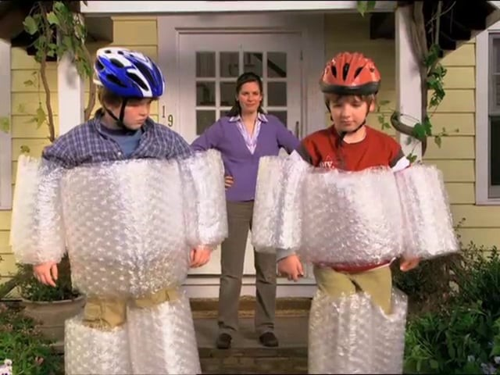
Secondary Playground Prevention

Slide 57
Keep Kids “SAFE”
S: Supervision
A: Appropriate Environment
F: Fall Surfacing
E: Equipment Maintenance

Slide 58
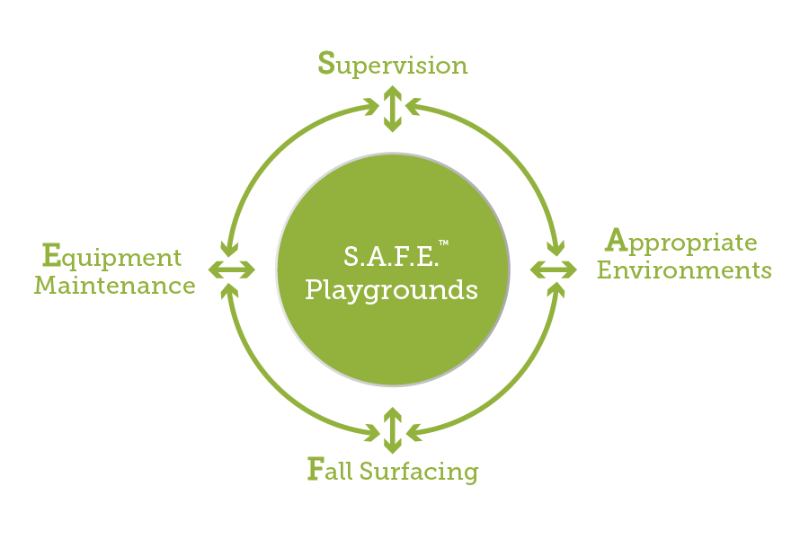
Keep Kids “SAFE”

Slide 59
Sports Safety
Every year, 2.6 million children between the ages of 0 and 19 years old are treated in the emergency department each year for sports and recreation-related injuries.
  That’s almost 7,124 kids a day!

Slide 60
Primary Prevention
Even if it’s not required; get young athletes a Preparticipation Physical Examination (PPE/Sports Physical)
  Medical History
  Physical Examination

Slide 61
PPE/Sports Physical
Medical History
    Allergies
    Medication Review
    Past Medical History

Slide 62
PPE/Sports Physical
Physical Examination:
  Height and Weight
  BP and pulse (heart rate and rhythm)
  Vision check
  Check the heart, lungs, abdomen, ears, nose, and throat
  Evaluate posture, joints, strength, and flexibility

Slide 63
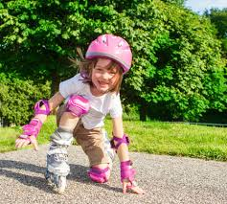
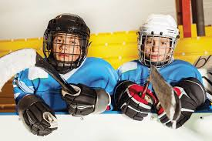
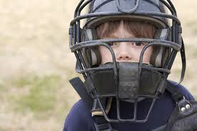
Secondary Prevention

Slide 64
Secondary Prevention
https://www.cdc.gov/headsup/youthsports/index.html

Slide 65
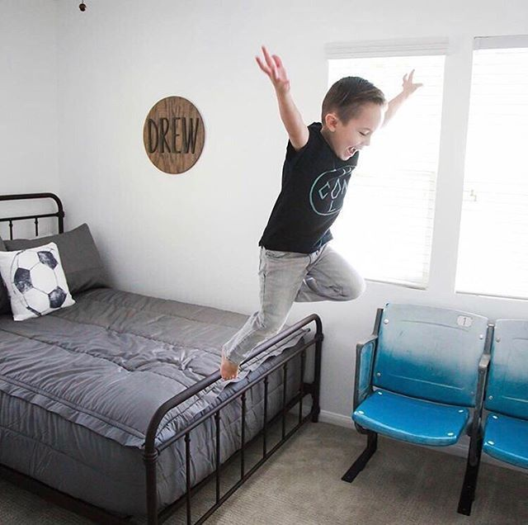
Falls

Slide 66
Falls
Leading cause of non-fatal injuries for all children ages 0 to 19
Approximately 8,000 children are treated in U.S. emergency rooms for fall-related injuries every day.
  This adds up to almost 2.8 million children each year

Slide 67
Primary Fall Prevention
Use guards on windows that are above ground level
Stair gates
Guard rails
  All of these devices can help keep a busy, active child from taking a dangerous tumble.

Slide 68
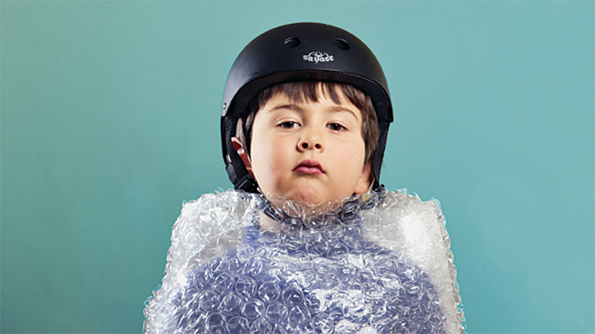
Secondary Fall Prevention

Slide 69

Road Traffic Safety

Slide 70
Road Traffic Safety
Nearly 150 children between ages 0 and 19 are treated in emergency departments for injuries sustained in motor vehicle crashes, every hour.
More children ages 5 to 19 die from crash-related injuries than from any other type of injury!
Six teens a day are killed in car crashes.

Slide 71
Teen Driving: Leading Causes of Accidents
Driver Inexperience
Nighttime Driving
Distracted Driving
Reckless Driving
Teen Passengers
Not using Seat Belts
Drowsy Driving
Impaired Driving

Slide 72
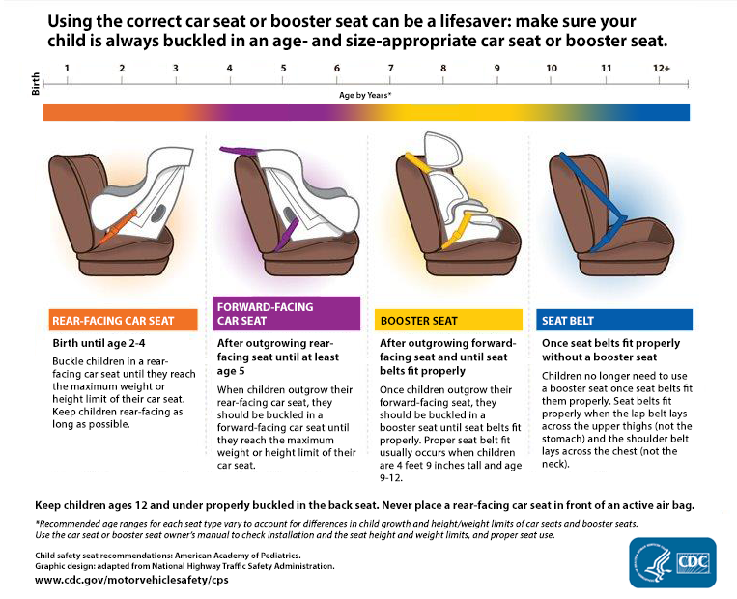
Car Seats

Slide 73
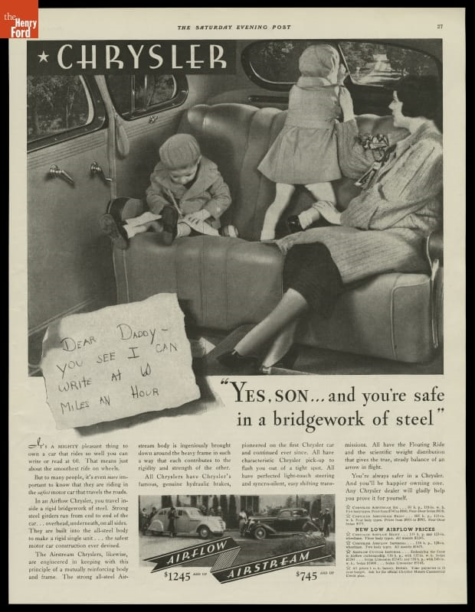
Car Seats: A review in time…

Slide 74
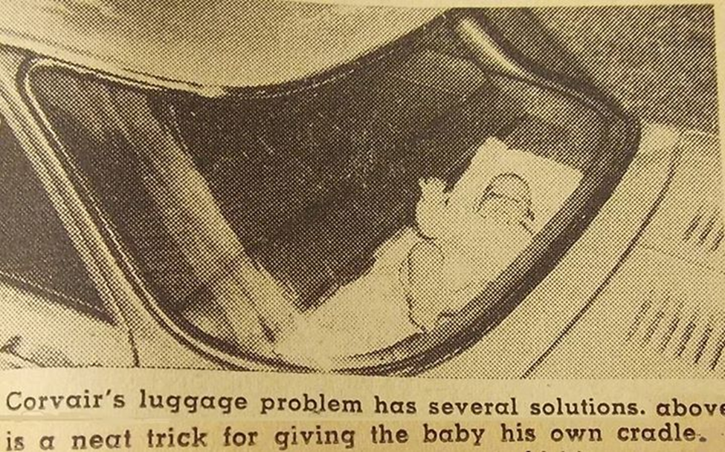
Car Seats: A review in time…

Slide 75
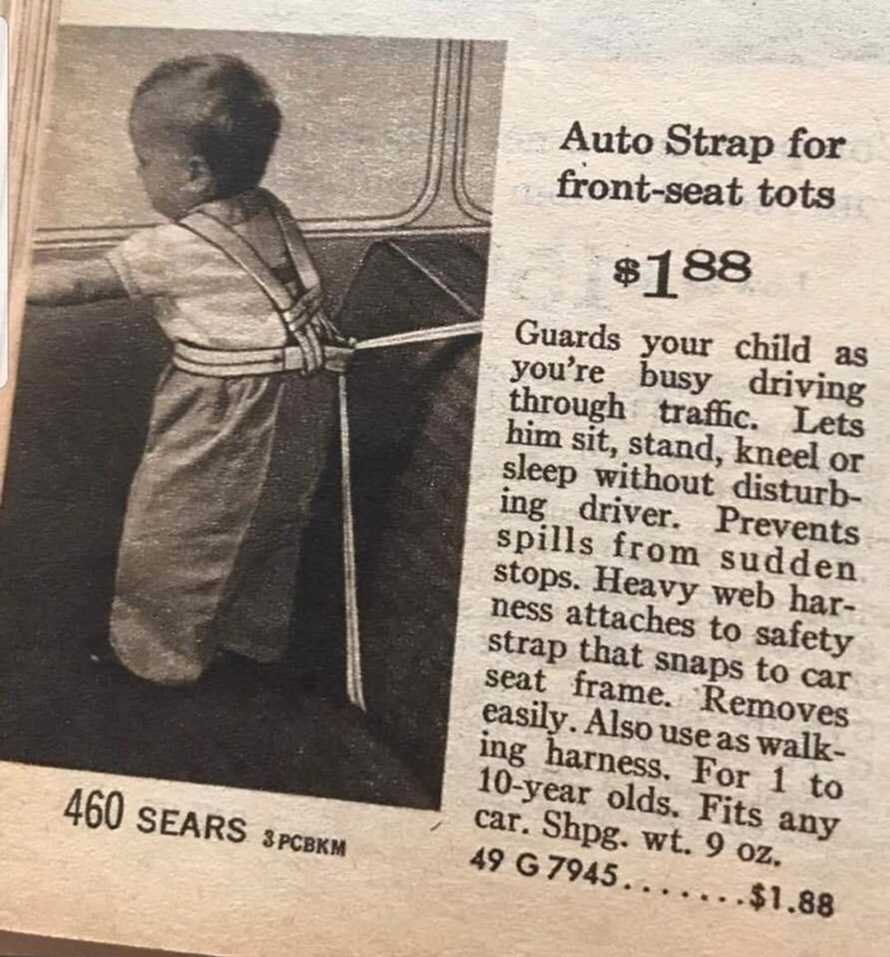
Car Seats: A review in time…

Slide 76
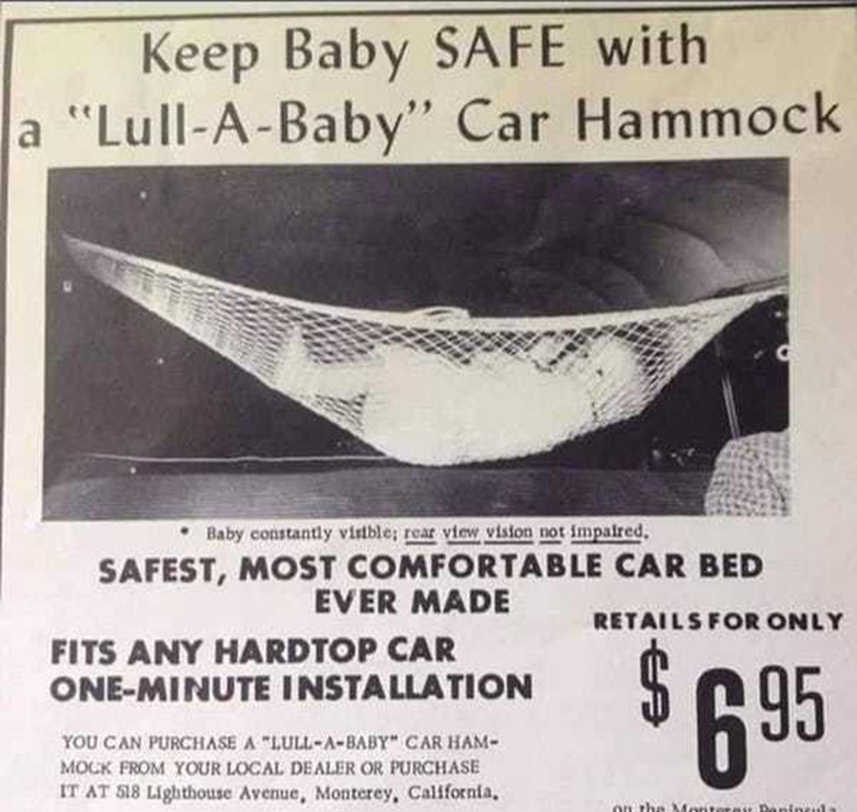
Car Seats: A review in time…

Slide 77
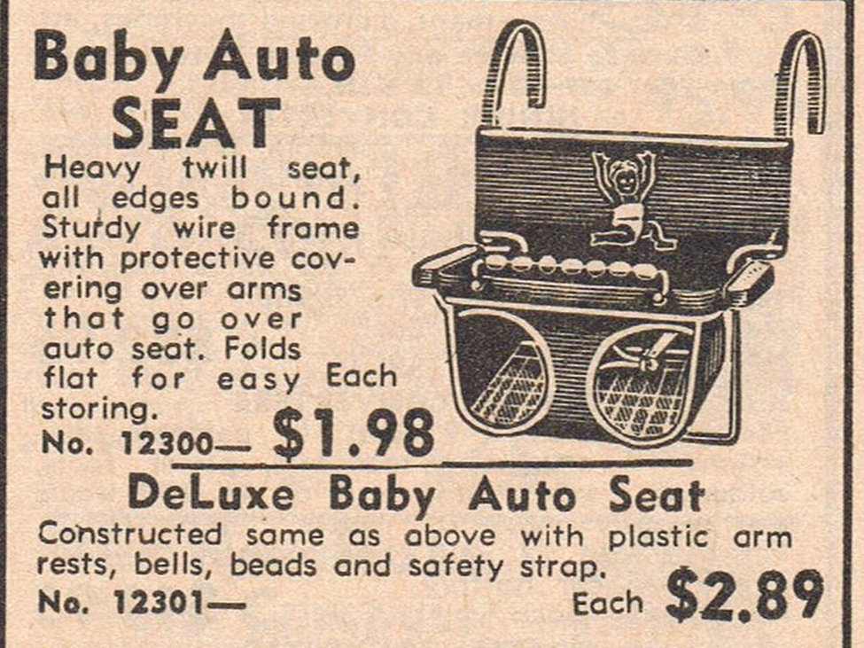
Car Seats: A review in time…

Slide 78
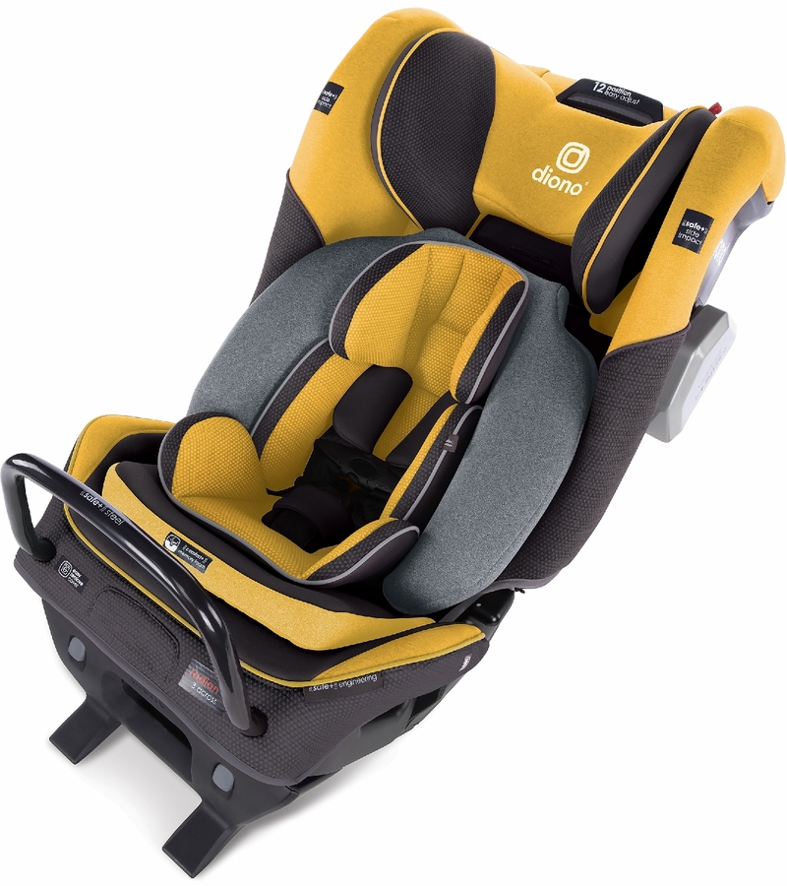
Car Seats: A review in time…

Slide 79
Secondary Prevention
NEMMCA 5-27 pg 3; Pediatric Patients and Car Seats:
a. Infants restrained in a rear-facing car seat may be immobilized and extricated in the car seat. The child may remain in the car seat if the immobilization is secure and his/her condition allows (no signs of respiratory distress or shock).
b. Children restrained in a car seat (with a high back) may be immobilized and extricated in the car seat; however, once removed from the vehicle, the child should have spinal precautions maintained as for an adult.
c. Children restrained in a booster seat (without a back) need to be extricated and immobilized following standard procedures.

Slide 80
Spinal Immobilization
The goal for pediatric spinal immobilization is the same for adults: Full body immobilization with neutral spine alignment
In order to achieve this, additional padding may be required (remember the occiput)

Slide 81
Cervical Collars
To begin with spinal immobilization, we need to first control the cervical spine. Once c-spine stabilization is manually taken, it cannot be released until it is secured. After manual stabilization is established, the next step is to place a cervical collar. Correct sizing is instrumental in ensuring a proper fit.

Slide 82
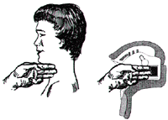
Cervical Collars
Photo courtesy ofwww.ezywrap.com

Slide 83
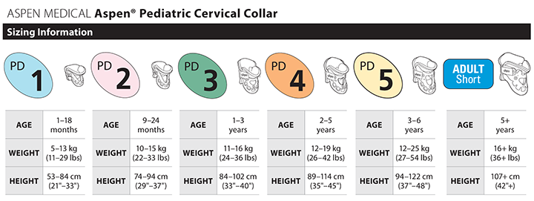
Cervical Collars

Slide 84
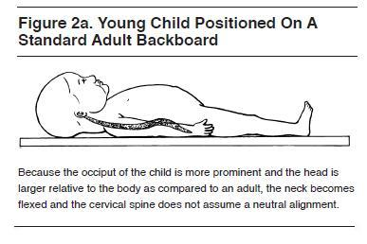
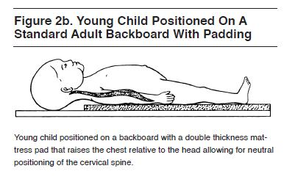
Spinal Immobilization
Photos from www.ebmedicine.net

Slide 85
Spinal Immobilization
There are a variety of devices available for pediatric spinal immobilization. Depending on the size of your patient, the equipment options will vary. However, many companies do not have commercially manufactured equipment. Therefore, we may have to modify adult equipment to fulfill our needs.

Slide 86
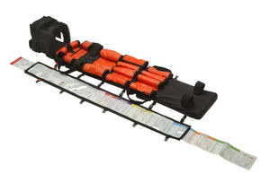
Spinal Immobilization

Slide 87
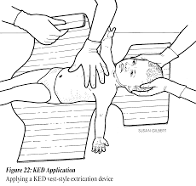
Spinal Immobilization
Photo courtesy of www.miemss.org

Slide 88
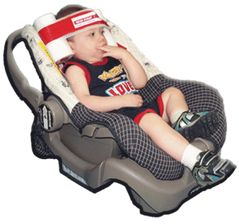
Spinal Immobilization
Photo courtesy ofitecems.com

Slide 89
Splinting
Simply defined, a splint is a device that is used to immobilize a part of the body. These devices may be commercially manufactured, or improvised from literally anything that can provide stability. Once again, most companies do not have commercially manufactured pediatric splints, so creativity must be used to adapt them to pediatric patients.

Slide 90
Splints
Can be soft or rigid
Prevents the movement of bone fragments, bone ends, or dislocated joints
Reduces the chance of further injury
Minimizes pain
Prevent a closed fracture from becoming an open fracture
Prevent paralysis of the extremities resulting from a damaged spine
Prevent damage to muscles, nerves, or blood vessels

Slide 91
Splinting Guidelines
Assess C.M.S pre/post splinting
Immobilize the joint above and below an injury to a long bone
Remove all clothing around the injury
Remove all jewelry, especially distal to the injury, because it may become entrapped by swelling
Cover all wounds, including open fractures, with sterile dressing before applying a splint, then gently bandage, avoiding excessive pressure
Pad each splint to prevent pressure and discomfort

Slide 92
Splinting Guidelines
If the distal extremity does not have pulses, make ONE attempt to realign the injured limb with traction. If pain, resistance, or crepitus increase, STOP
Do not intentionally replace protruding bones
Apply the splint, if condition permits, prior to moving the patient
If the patient shows signs of shock, align the patient in the normal anatomical position, initiate treatment for shock, and immediately transport without applying a splint

Slide 93
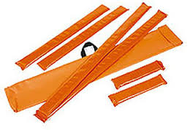
Rigid Splint

Slide 94
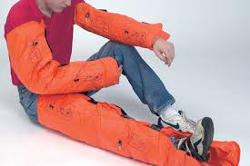
Vacuum Splint

Slide 95
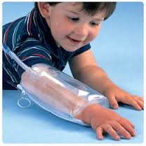
Pressure Splint

Slide 96
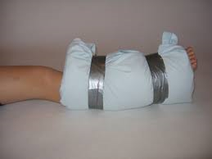
Improvised Splint

Slide 97
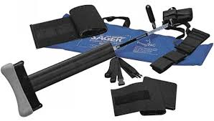
Traction Splint

Slide 98
Traumatic Brain Injury
Transport Pediatric patients that receive a bump, blow, or jolt to the head or body, and:
  Headache that gets worse and does not go away.
  Weakness, numbness, or decreased coordination.
  Repeated vomiting or nausea.
  Slurred speech.
  Look very drowsy or cannot wake up.
  Have one pupil (the black part in the middle of the eye) larger than the other.
  Have convulsions or seizures.

Slide 99
TBI cont.
  Cannot recognize people or places.
  Are getting more and more confused, restless, or agitated.
  Have unusual behavior.
  Lose consciousness.
  Danger Signs in Children
  Will not stop crying and are inconsolable.
  Will not nurse or eat.

Slide 100
Avoid the “H Bombs”
Hyperventilation
Hypotension
Hypoxia

Slide 101
Abuse
2013 National Abuse Statistics ¹
An estimated 679,000 children were victims of abuse and neglect (unique instances).
47 states reported approximately 3.1 million children received preventative services from Child Protective Services agencies in the United States.
Children in the first year of their life had the highest rate of victimization of 23.1 per 1,000 children in the national population of the same age.
Of the children who experienced maltreatment or abuse, nearly 80% suffered neglect; 18% suffered physical abuse; and 9% suffered sexual abuse.
Just under 80% of reported child fatalities as a result of abuse and neglect were caused by one or more of the child victim’s parents.
http://www.nationalchildrensalliance.org/media-room/media-kit/national-statistics-child-abuse

Slide 102
Abuse
Abuse doesn’t solely refer to bruises or broken bones. There are four classifications of abuse:
Emotional Abuse
Physical Abuse
Physical Neglect
Sexual Abuse

Slide 103
Emotional Abuse
Damaging to a child’s mental health and social development. Examples include:
  Belittling, Shaming, and Humiliating a child
  Frequent yelling, threatening, or bullying
  Name calling
  Limited physical contact with a child
  Lack of affection
  Telling a child they were a “mistake”

Slide 104

Physical Abuse

Slide 105

Physical Neglect

Slide 106

Sexual Abuse

Slide 107
Mandatory Reporters
Physicians
Licensed Master Social Workers
Licensed Bachelor’s Social Workers
PA’s
Registered Social Service Technicians
Medical Examiners
Nurses
School Administrators
LICENSED EMERGENCY MEDICAL CARE PROVIDERS
School Counselors
Teachers
Psychologists
LEO’s
Marriage & Family Therapists
Members of the Clergy
Licensed Professional Counselors
Social Workers

Slide 108
Reporting Process
Mandatory Reporters are required to make an IMMEDIATE verbal report to Child Protective Services.(CPS) Also, mandated reporters must notify the head of their organization of the report.
Mandated reporters are also required to submit a written report to the Department of Human Services within 72 hours.

Slide 109
Verbal Report
The verbal report can be completed by calling:
(855) 444-3911
Name and address of primary caretaker
Names and birth dates for all household members
Name(s) and birth date(s) of the alleged perpetrator(s)
Does the alleged perpetrator(s) live with the child
Address where the alleged abuse/neglect occurred
What makes you suspect the child is being abused/neglected

Slide 110
3200 Form
Form that DHS prefers to be completed for the written report
If more than one mandatory reporter suspects abuse/neglect, based upon the same incident, they may submit just one DHS-3200 form
Under the Child Protection Law, the identity of the person reporting is confidential. Your identity is subject to disclosure only with your consent, by judicial process, or to those listed under Section 5 of the Child Protection Law (MCL 722.625)

Slide 111
3200 Form
The Child Protection Law requires that the written report include the following information:
Name of child
Description of abuse/neglect
Name(s) and address(es) of child’s parents/guardians
The person with whom the child resides
Child’s age
Other information available to the reporting person that might establish the cause of the abuse/neglect, and the manner in which the abuse/neglect occured

Slide 112
Civil and Criminal Liability
“Mandated reporters, who fail to file a report of suspected child abuse or neglect, WILL BE SUBJECT to both CIVIL and CRIMINAL LIABILITY. In a civil action, the mandated reporter may be held liable for all damages that any person suffers due to the mandated reporters’ failure to file a report. In a criminal action, the mandated reporter may be found GUILTY OF A MISDEMEANOR punishable by IMPRISONMENT for up to 93 days and a fine of $500.”
http://www.michigan.gov/mdhhs/0,5885,7-339-73971_7119_50648_7193_7812-157836--,00.html

Slide 113

PeBLS

